Slide 1
Inheritance
[Reusable Properties]
Prepared using following Resources:
Herbert Schildt, “Java: The Complete Reference”, Tata McGrawHill Education
E Balagurusamy, Programming with Java - A Tata McGraw Hill Education
https://www.geeksforgeeks.org/java/
https://www.javatpoint.com/java-tutorial
https://www.tutorialspoint.com/java/index.htm
https://www.w3schools.com/java/
By: DIVAKARA .N

Slide 2

INHERITANCE: Super class & subclasses including multilevel hierarchy, process of constructor calling in inheritance, use of ‘super’ and ‘final’ keywords with super() method, dynamic method dispatch, use of abstract classes & methods, Method call binding, Overriding vs. overloading, Abstract classes and methods, Constructors and polymorphism, Order of constructor calls.

Slide 3

Inheritance is one of the cornerstones of object-oriented programming because it allows the creation of hierarchical classifications.
Using inheritance, you can create a general class that defines traits common to a set of related items. This class can then be inherited by other, more specific classes, each adding those things that are unique to it.
In the terminology of Java, a class that is inherited is called a superclass. The class that does the inheriting is called a subclass.
Therefore, a subclass is a specialized version of a superclass. It inherits all of the instance variables and methods defined by the superclass and adds its own, unique elements.

Slide 4
Inheritance Basics
To inherit a class, you simply incorporate the definition of one class into another by using the extends keyword.
The general form of a class declaration that inherits a superclass:
  class subclass-name extends superclass-name {
  // body of class
  }
You can only specify one superclass for any subclass that you create. Java does not support the inheritance of multiple superclasses into a single subclass. You can, as stated, create a hierarchy of inheritance in which a subclass becomes a superclass of another subclass. However, no class can be a superclass of itself.

Slide 5
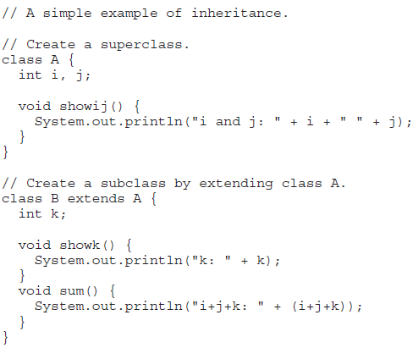
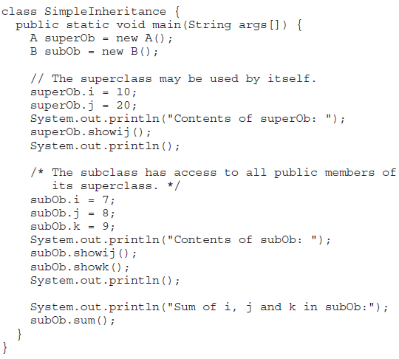
Inheritance Basics ...

Slide 6
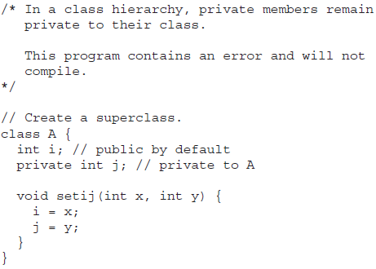
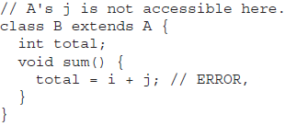
Inheritance Basics ...
Member Access and Inheritance: Although a subclass includes all of the members of its superclass, it cannot access those members of the superclass that have been declared as private.
REMEMBER A class member that has been declared as private will remain private to its class. It is not accessible by any code outside its class, including subclasses.

Slide 7
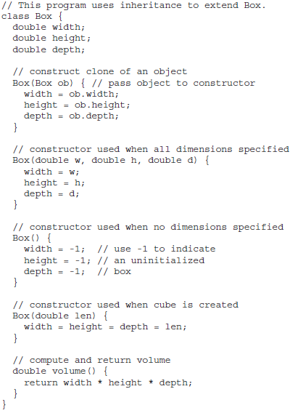
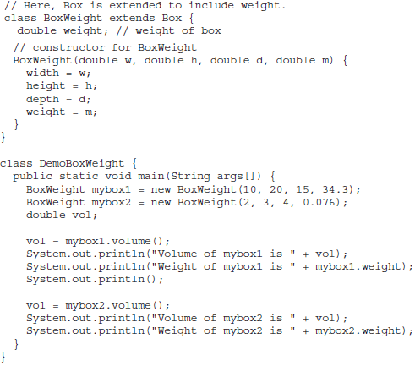
Inheritance Basics ... More Practical Example

Slide 8
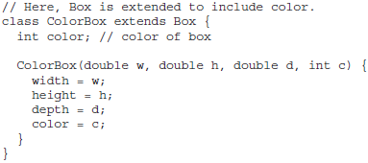
Inheritance Basics ... More Practical Example
A major advantage of inheritance is that once you have created a superclass that defines the attributes common to a set of objects, it can be used to create any number of more specific subclasses. Each subclass can precisely tailor its own classification. For example, the following class inherits Box and adds a color attribute:
Remember: Once you have created a superclass that defines the general aspects of an object, that superclass can be inherited to form specialized classes. Each subclass simply adds its own unique attributes. This is the essence of inheritance.

Slide 9
Inheritance Basics ...
A Superclass Variable Can Reference a Subclass Object:
A reference variable of a superclass can be assigned a reference to any subclass derived from that superclass.
It is important to understand that it is the type of the reference variable — not the type of the object that it refers to — that determines what members can be accessed. That is, when a reference to a subclass object is assigned to a superclass reference variable, you will have access only to those parts of the object defined by the superclass, because the superclass has no knowledge of what a subclass adds to it.

Slide 10
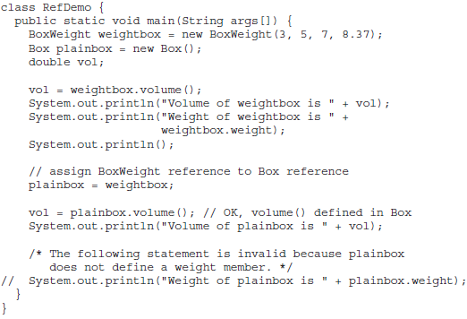
Inheritance Basics ...
A Superclass Variable Can Reference a Subclass Object: ...

Slide 11
Using super
Whenever a subclass needs to refer to its immediate superclass, it can do so by use of the keyword super.
super has two general forms.
  The first calls the superclass’ constructor.
  The second is used to access a member of the superclass that has been hidden by a member of a subclass.

Slide 12
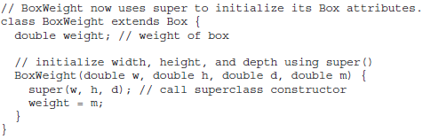
Using super ...
Using super to Call Superclass Constructors
A subclass can call a constructor defined by its superclass by use of the following form of super:
super(arg-list);
Here, arg-list specifies any arguments needed by the constructor in the superclass. super( ) must always be the first statement executed inside a subclass’ constructor.

Slide 13
Using super ...
Using super to Call Superclass Constructors...
Since constructors can be overloaded, super( ) can be called using any form defined by the superclass.
The constructor executed will be the one that matches the arguments.

Slide 14
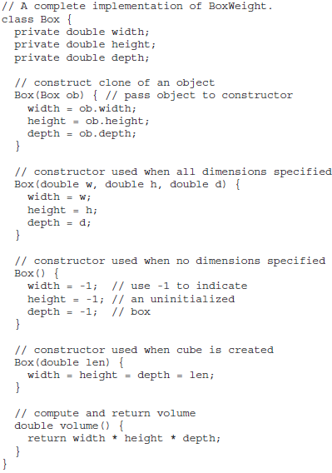
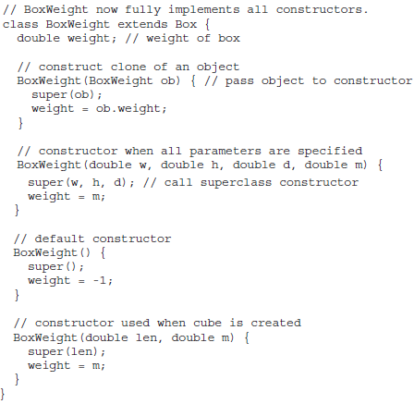
Using super ...
Using super to Call Superclass Constructors...

Slide 15

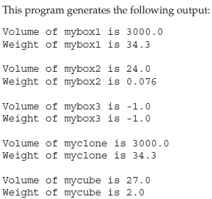
Using super ...
Using super to Call Superclass Constructors...

Slide 16

Using super ...
Using super to Call Superclass Constructors...
Notice that super( ) is passed an object of type BoxWeight—not of type Box. This still invokes the constructor Box(Box ob). As mentioned earlier, a superclass variable can be used to reference any object derived from that class.
Thus, we are able to pass a BoxWeight object to the Box constructor. Of course, Box only has knowledge of its own members.
When a subclass calls super( ), it is calling the constructor of its immediate superclass. Thus, super( ) always refers to the superclass immediately above the calling class.
This is true even in a multileveled hierarchy. Also, super( ) must always be the first statement executed inside a subclass constructor.

Slide 17
Using super ...
A Second Use for super
Acts somewhat like this, except that it always refers to the superclass of the subclass in which it is used. This usage has the following general form:
super.member
Here, member can be either a method or an instance variable.
This second form of super is most applicable to situations in which member names of a subclass hide members by the same name in the superclass.

Slide 18
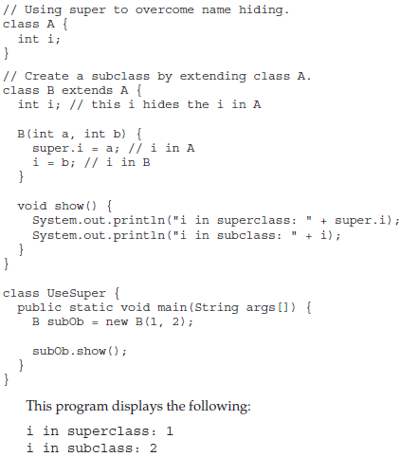
Using super ...
A Second Use for super ...
Although the instance variable i in B hides the i in A, super allows access to the i defined in the superclass.
As you will see, super can also be used to call methods that are hidden by a subclass.

Slide 19
Creating a Multilevel Hierarchy
Builds hierarchies that contain as many layers of inheritance, uses a subclass as a superclass of another.

Slide 20
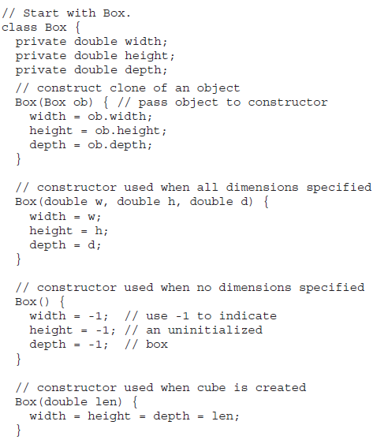
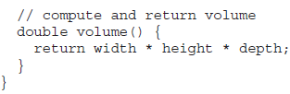
Creating a Multilevel Hierarchy:...

Slide 21
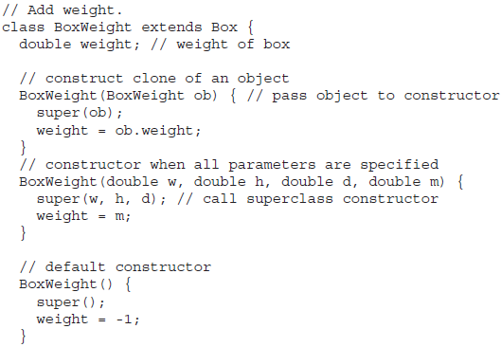
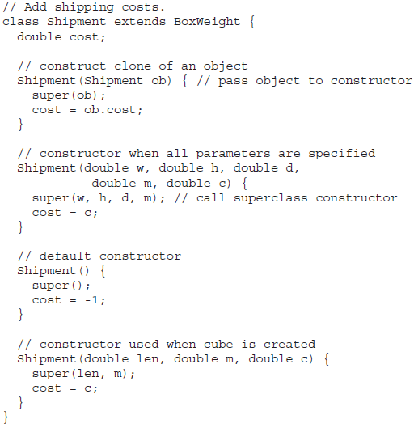
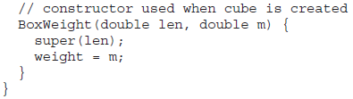
Creating a Multilevel Hierarchy:...

Slide 22
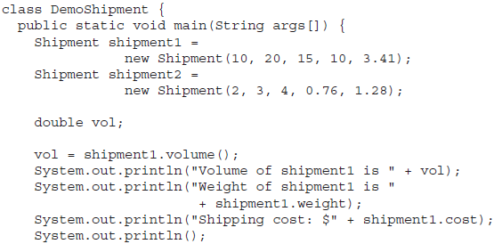
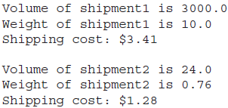
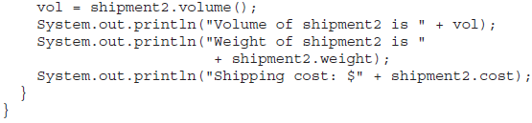
Creating a Multilevel Hierarchy:...
The entire class hierarchy, including Box, BoxWeight, and Shipment, is shown all in one file. In Java, all three classes could have been placed into their own files and compiled separately. In fact, using separate files is the norm, not the exception, in creating class hierarchies.

Slide 23
In a class hierarchy, constructors are called in order of derivation, from superclass to subclass.
Further, since super( ) must be the first statement executed in a subclass’ constructor, this order is the same whether or not super( ) is used.
If super( ) is not used, then the default or parameterless constructor of each superclass will be executed.

Slide 24
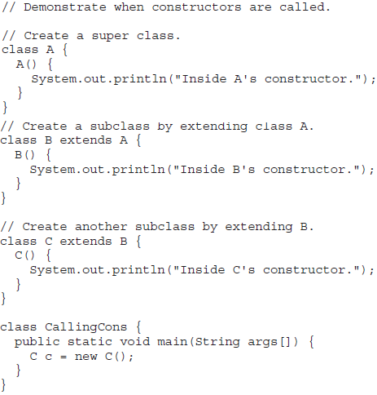

The constructors are called in order of derivation, it makes sense that constructors are executed in order of derivation.
Because a superclass has no knowledge of any subclass, any initialization it needs to perform is separate from and possibly prerequisite to any initialization performed by the subclass. Therefore, it must be executed first.

Slide 25
Method Overriding:
In a class hierarchy, when a method in a subclass has the same name and type signature as a method in its superclass, then the method in the subclass is said to override the method in the superclass.
When an overridden method is called from within a subclass, it will always refer to the version of that method defined by the subclass. The version of the method defined by the superclass will be hidden.

Slide 26
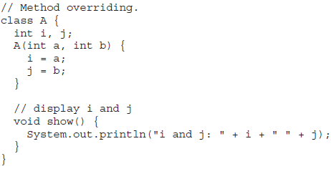
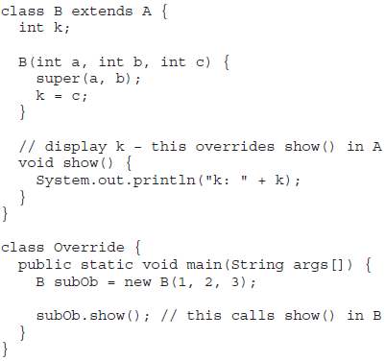
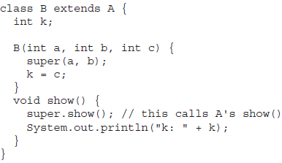
Method Overriding:...
When show( ) is invoked on an object of type B, the version of show( ) defined within B is used. That is, the version of show( ) inside B overrides the version declared in A. To access the superclass version of an overridden method, you can do so by using super.

Slide 27
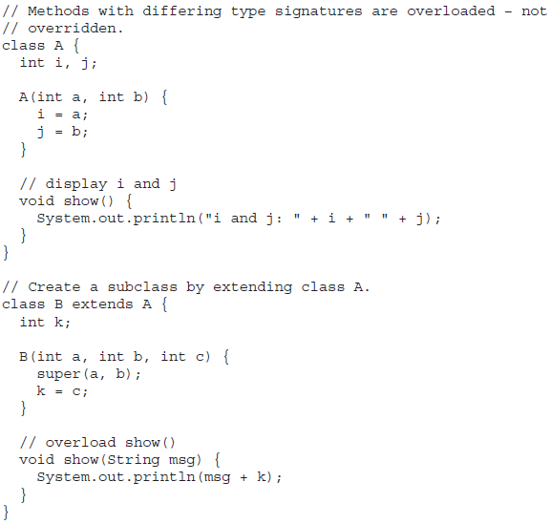
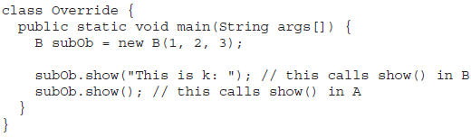
Method Overriding:...
Method overriding occurs only when the names and the type signatures of the two methods are identical.
If they are not, then the two methods are simply overloaded.

Slide 28
Dynamic Method Dispatch:
Method overriding forms the basis for one of Java’s most powerful concepts: dynamic method dispatch.
Dynamic method dispatch is the mechanism by which a call to an overridden method is resolved at run time, rather than compile time.
Dynamic method dispatch is important because this is how Java implements run-time polymorphism.
An important principle: A superclass reference variable can refer to a subclass object.
Java uses this fact to resolve calls to overridden methods at run time.

Slide 29
Dynamic Method Dispatch:...
When an overridden method is called through a superclass reference, Java determines which version of that method to execute based upon the type of the object being referred to at the time the call occurs.
Thus, this determination is made at run time. When different types of objects are referred to, different versions of an overridden method will be called.

Slide 30
Dynamic Method Dispatch:...
In other words, it is the type of the object being referred to (not the type of the reference variable) that determines which version of an overridden method will be executed.
Therefore, if a superclass contains a method that is overridden by a subclass, then when different types of objects are referred to through a superclass reference variable, different versions of the method are executed.

Slide 31
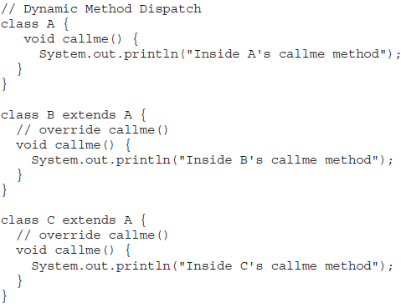
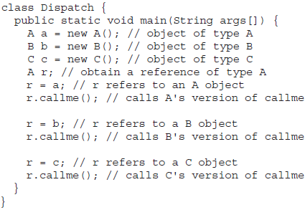
Dynamic Method Dispatch:...

Slide 32
Dynamic Method Dispatch:...
Why Overridden Methods?
Overridden methods allow Java to support run-time polymorphism. Polymorphism is essential to object-oriented programming for one reason: It allows a general class to specify methods that will be common to all of its derivatives, while allowing subclasses to define the specific implementation of some or all of those methods.
Overridden methods are another way that Java implements the “One interface, Multiple methods” aspect of polymorphism.

Slide 33
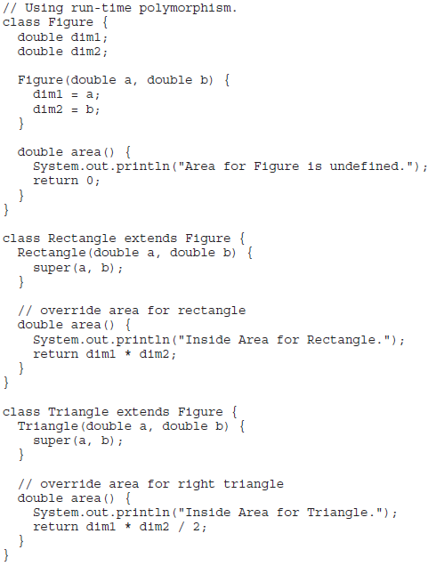
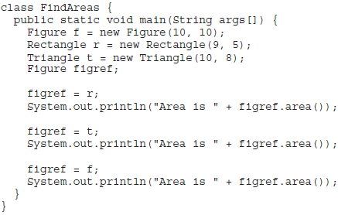
Dynamic Method Dispatch:...Applying Method Overriding

Slide 34
Using Abstract Classes:
There are situations in which you will want to define a superclass that declares the structure of a given abstraction without providing a complete implementation of every method.
Sometimes you will want to create a superclass that only defines a generalized form that will be shared by all of its subclasses, leaving it to each subclass to fill in the details. Such a class determines the nature of the methods that the subclasses must implement.
One way this situation can occur is when a superclass is unable to create a meaningful implementation for a method.

Slide 35
Using Abstract Classes:...
You can require that certain methods be overridden by subclasses by specifying the abstract type modifier. These methods are sometimes referred to as subclasser responsibility because they have no implementation specified in the superclass. Thus, a subclass must override them—it cannot simply use the version defined in the superclass.
To declare an abstract method, use this general form:
abstract type name(parameter-list);
No method body is present.

Slide 36
Using Abstract Classes:...
Any class that contains one or more abstract methods must also be declared abstract.
To declare a class abstract, you simply use the abstract keyword in front of the class keyword at the beginning of the class declaration.
There can be no objects of an abstract class. That is, an abstract class cannot be directly instantiated with the new operator. Such objects would be useless, because an abstract class is not fully defined. Also, you cannot declare abstract constructors, or abstract static methods.
Any subclass of an abstract class must either implement all of the abstract methods in the superclass, or be itself declared abstract.

Slide 37
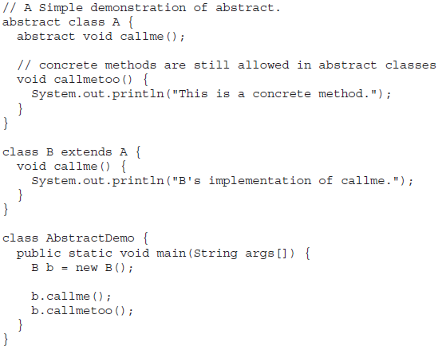
Using Abstract Classes:... An Example
Abstract classes can include as much implementation as they see fit.
Although abstract classes cannot be used to instantiate objects, they can be used to create object references, because Java’s approach to run-time polymorphism is implemented through the use of superclass references.
Thus, it must be possible to create a reference to an abstract class so that it can be used to point to a subclass object.

Slide 38
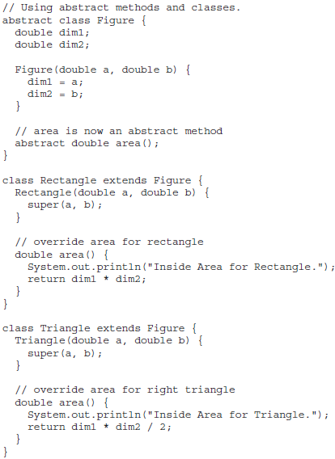
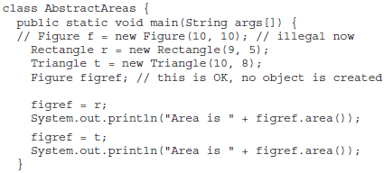
Using Abstract Classes:... An Example

Slide 39
Using final with Inheritance:
The keyword final has three uses.
  First, it can be used to create the equivalent of a named constant.
  The other two uses of final apply to inheritance.
Using final to Prevent Overriding
To disallow a method from being overridden, specify final as a modifier at the start of its declaration. Methods declared as final cannot be overridden.

Slide 40
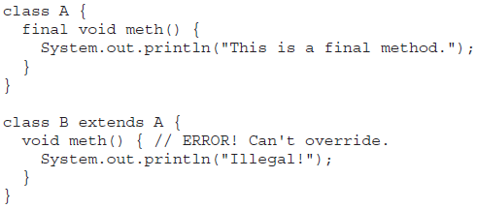
Using final with Inheritance:...
Using final to Prevent Overriding
To disallow a method from being overridden, specify final as a modifier at the start of its declaration. Methods declared as final cannot be overridden.

Slide 41
Using final with Inheritance:...
Using final to Prevent Overriding...
Methods declared as final can sometimes provide a performance enhancement: The compiler is free to inline calls to them because it “knows” they will not be overridden by a subclass. When a small final method is called, often the Java compiler can copy the bytecode for the subroutine directly inline with the compiled code of the calling method, thus eliminating the costly overhead associated with a method call.
Inlining is only an option with final methods. Normally, Java resolves calls to methods dynamically, at run time. This is called late binding. However, since final methods cannot be overridden, a call to one can be resolved at compile time. This is called early binding.

Slide 42
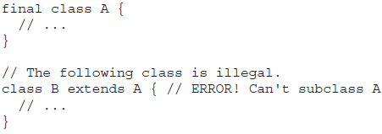
Using final with Inheritance:...
Using final to Prevent Inheritance
Sometimes you will want to prevent a class from being inherited. To do this, precede the class declaration with final. Declaring a class as final implicitly declares all of its methods as final, too.
It is illegal to declare a class as both abstract and final since an abstract class is incomplete by itself and relies upon its subclasses to provide complete implementations.

Slide 43
The Object Class:
There is one special class, Object, defined by Java. All other classes are subclasses of Object.
That is, Object is a superclass of all other classes. This means that a reference variable of type Object can refer to an object of any other class.
Also, since arrays are implemented as classes, a variable of type Object can also refer to any array.

Slide 44
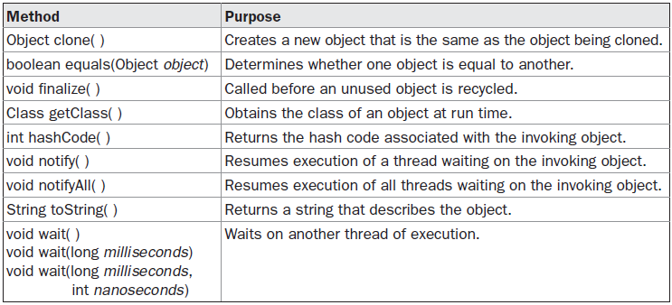
The Object Class:...
Object defines the following methods, which means that they are available in every object.

Slide 45
Additional Coverage:
Inheritance in java is a mechanism in which one object acquires all the properties and behaviors of parent object.
The idea behind inheritance in java is that you can create new classes that are built upon existing classes. When you inherit from an existing class, you can reuse methods and fields of parent class, and you can add new methods and fields also.
Inheritance represents the IS-A relationship, also known as parent-child relationship. IS-A is a way of saying: This object is a type of that object.

Slide 46
Additional Coverage:...
The extends keyword is used to achieve inheritance.
  public class Animal{
  }
    public class Mammal extends Animal{
    }
    public class Reptile extends Animal{
    }
      public class Dog extends Mammal{
      }

Slide 47
Additional Coverage:...Example
  public class Animal{
  }
  public class Mammal extends Animal{
  }
  public class Dog extends Mammal{
  public static void main(String args[]){
  Animal a = new Animal();
  Mammal m = new Mammal();
  Dog d = new Dog();
  System.out.println(m instanceof Animal);
  System.out.println(d instanceof Mammal);
  System.out.println(d instanceof Animal);
  }
  }

Slide 48
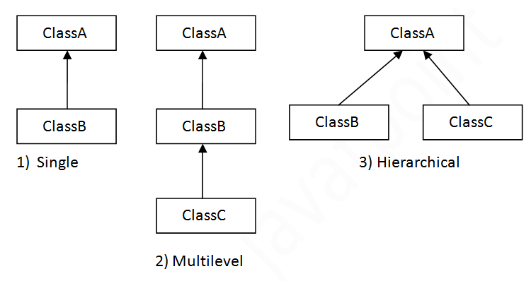
Additional Coverage:...
Why use inheritance in java?
  For Method Overriding (so runtime polymorphism can be achieved).
  For Code Reusability.
  Types:

Slide 49
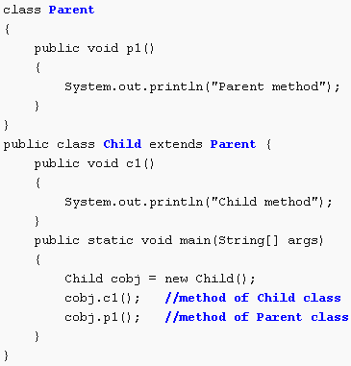
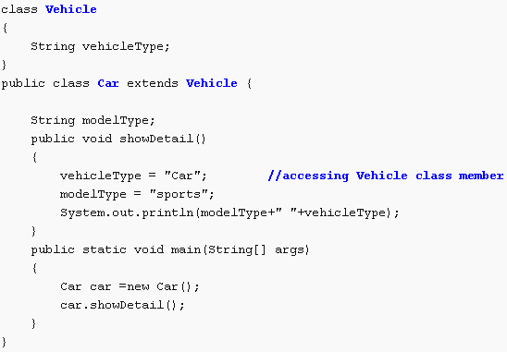
Additional Coverage:...Examples

Slide 50
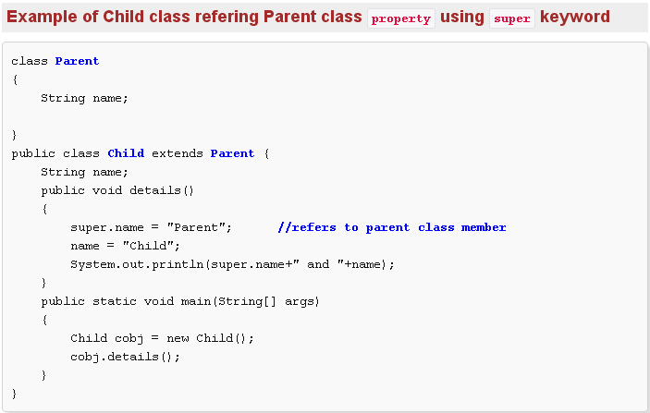
Additional Coverage:...Examples

Slide 51
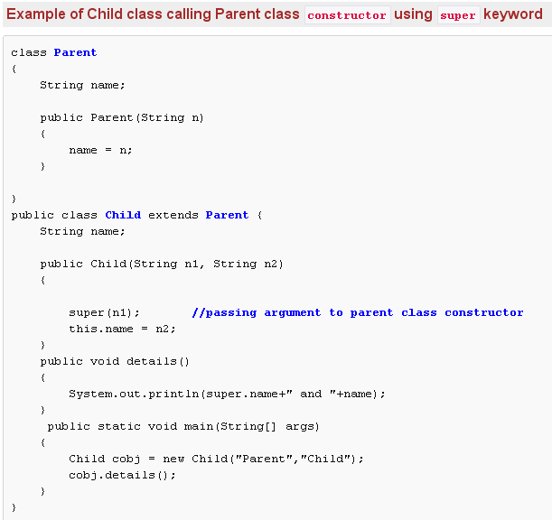
Additional Coverage:...Examples

